Slide 1
Unit 4
Did you go to
the party?
Lesson 2

Slide 2
VOCABULARY

Slide 3
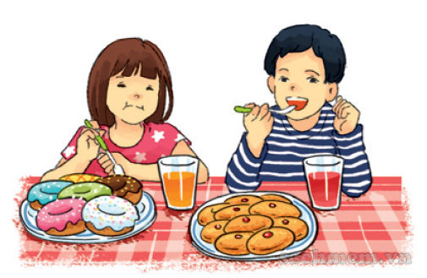
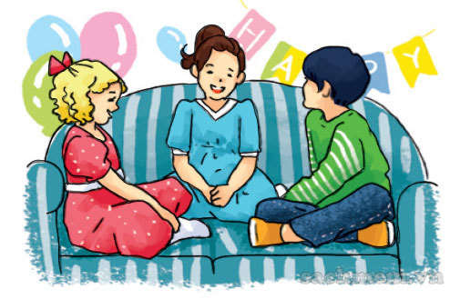
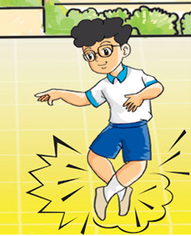
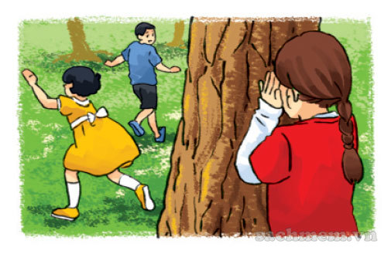
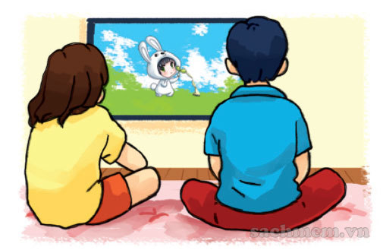
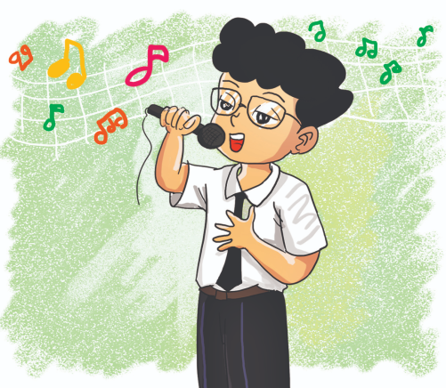
A. Vocabulary
Verd – (v)
eat
- have
chat
dance
ăn
nói chuyện
nhảy
play
watch
sing
chơi
xem
hát

Slide 4
GRAMMAR

Slide 5
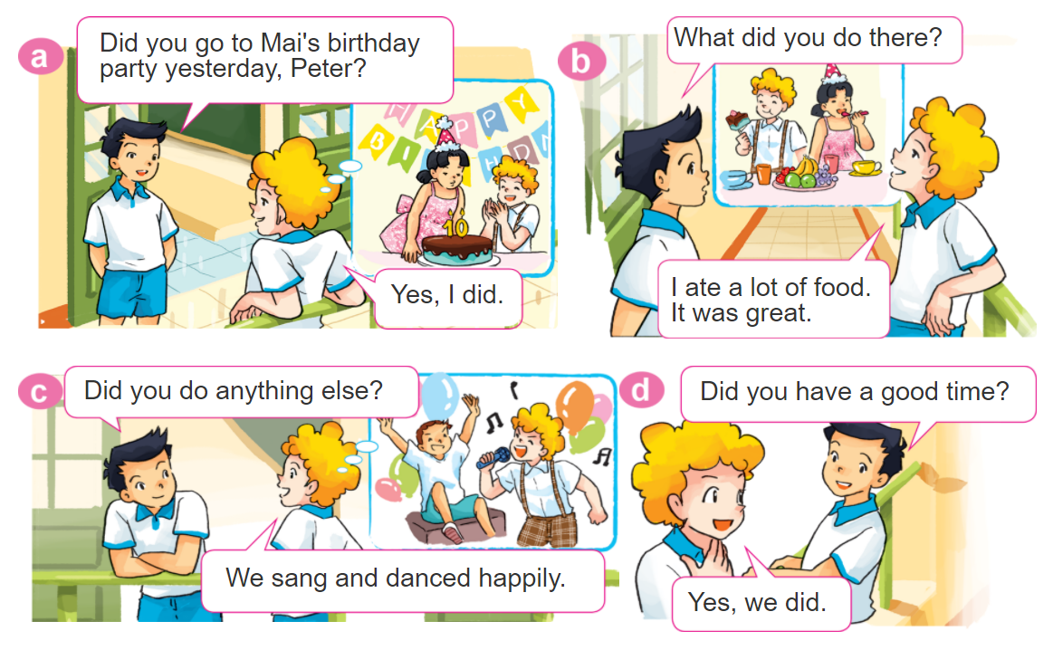
1. Look, listen and repeat.

Slide 6
B. Grammar
Cách nói đã làm một hoạt động (Ved/V2):
chat
play
watch
dance
eat / have
sing
nói chuyện
chơi
xem
Nhảy
ăn
Nhảy
chatted
played
watched
danced
ate / had
sang
Đã n.chuyện
đã chơi
Đã xem
Đã nhảy
Đã ăn
Đã hát

Slide 7
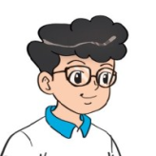
2. Point and say
What did you do at the party?
We ___________.
had nice
food and drink
watched cartoons
played
hide-and-seek
chatted
with friends

Slide 8
B. Grammar
Hỏi và đáp các bạn đã làm gì ở bữa tiệc:
What did you do at the party?
+ Ved/V2
We ________________.
Hỏi và đáp bữa tiệc đã như thế nào?
How was the party (it)?
It was _______.
+ adj

Slide 9
3. Let’s talk
Did you ________?
Yes. I did.
No, I didn't.
How was it?
It was________.
What did you do there?
I/We ____________.

Slide 10
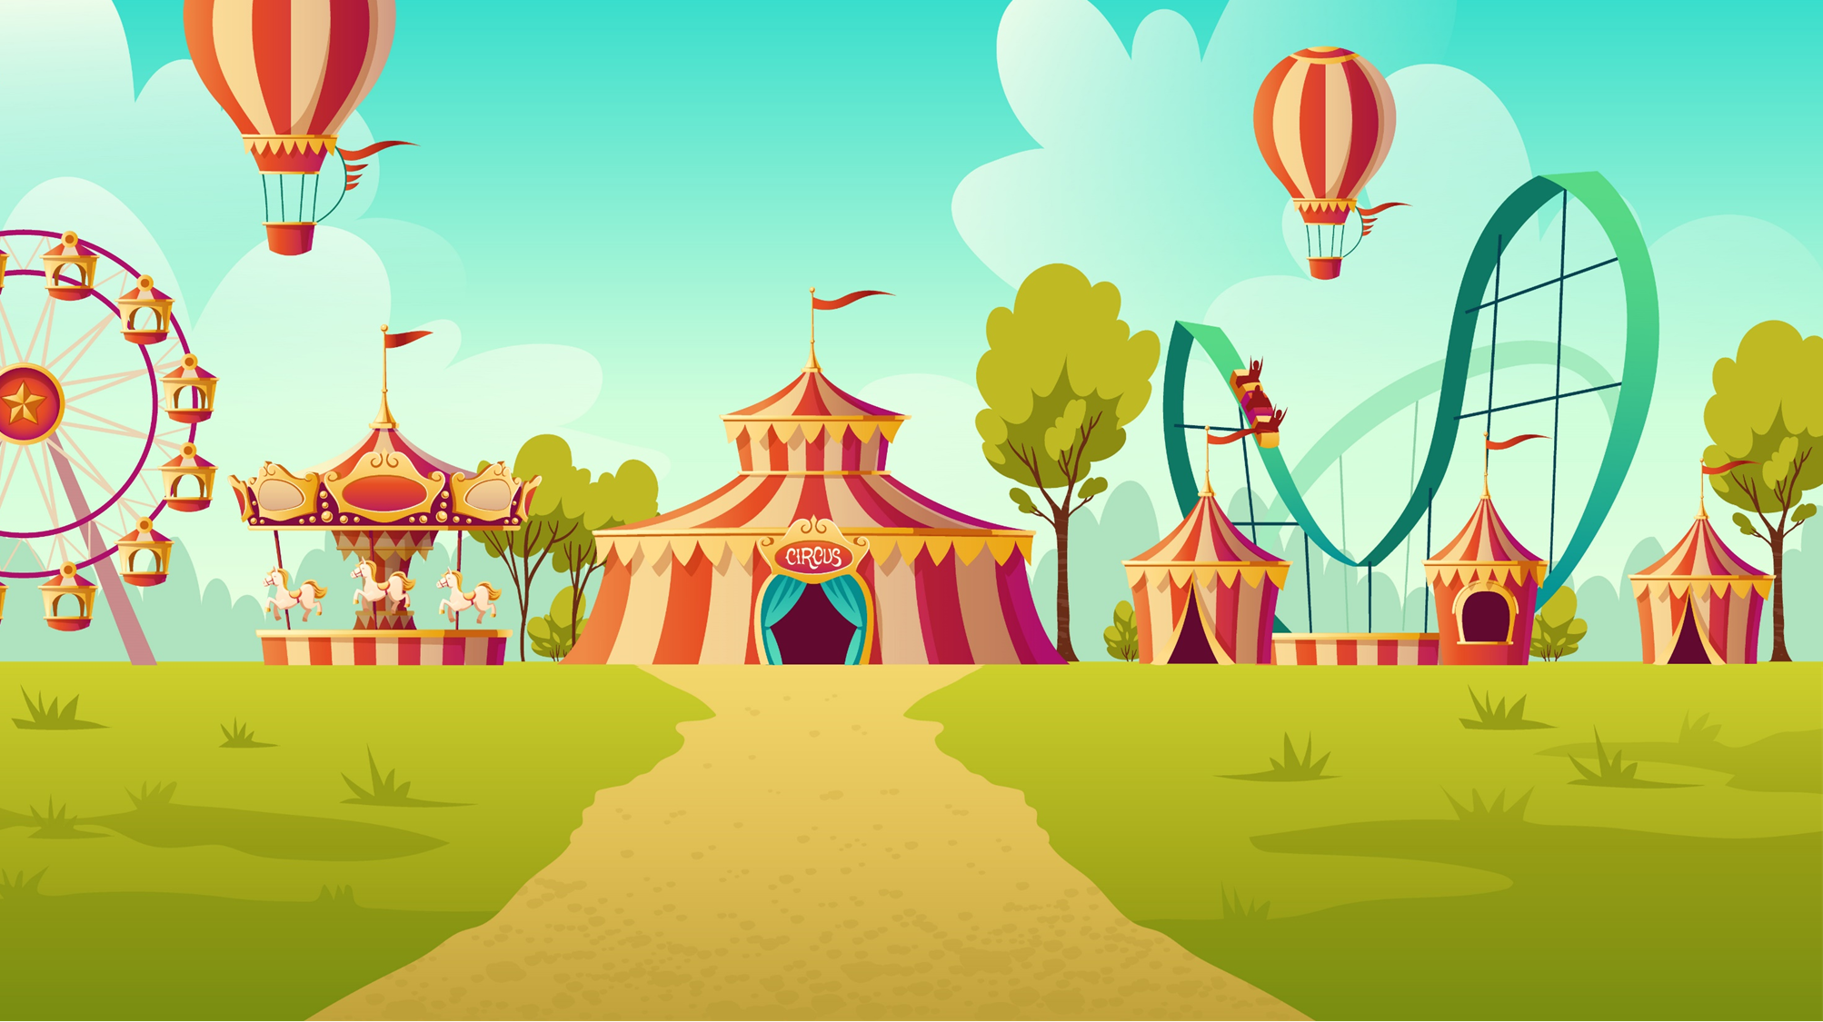
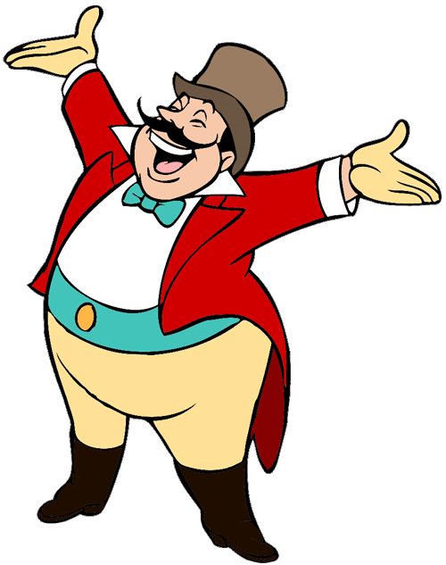
START

Slide 11
What did you do at the party?
We sing many songs.
We sang many songs.
We singed happily.

Slide 12
What did you do at the party?
We chat with my friends.
We chatted with my friends.
We chated with my friends.

Slide 13
What did you do at the party?
We play hide-and-seek.
We plays hide-and-seek.
We played hide-and-seek.

Slide 14
What did you do at the party?
We had nice food and drink.
We have nice food and drink.
We eat nice food and drink.
Next

Slide 15
What did you do at the party?
We dances happily.
We dance happily.
We danced happily.

Slide 16
What did you do at the party?
We watched cartoon.
We watch cartoon.
We watches cartoon.
Next

Slide 17
What ___ you do at the party?
We had nice food and drink.
do
did
was

Slide 18
What did you ____
at the party?
was
did
do

Slide 19
Ms Huyền Phạm
0936.082.789

Slide 20
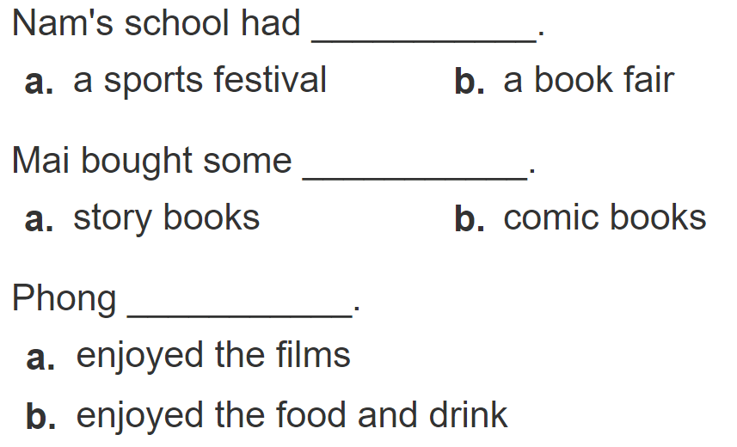
4. Listen and circle
1
2
3

Slide 21
5. Write about you.
Where were you yesterday?
__________________________________.
2. What did you do there?
__________________________________.
3. Did you enjoy it?
__________________________________.

Slide 22
6. Let’s play

Slide 23
THANK YOU!
Welcome to join with me!

